Slide 2
About Today…
Middlewares
Working
Types
Usage

Slide 3


Slide 4

Intro to Middleware
Definition
Functions that have access to the request object (req), the response object
(res), and the next middleware function in the application’s request-response cycle
Purpose
To modify the req and res objects, end the request-response cycle, or call the
next middleware function

Slide 5
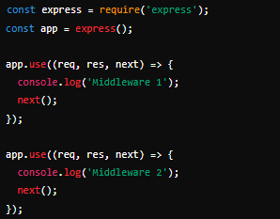
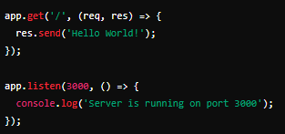
How Middleware Works
Middleware Flow
The middleware functions execute sequentially in the order they are defined
in the application
Example Code

Slide 6
Types of Middleware
Application-Level Middleware
Defined on the application object using app.use() or app.METHOD()
Router-Level Middleware
Similar to application-level middleware but bound to an instance of express.Router()
Built-in Middleware
Provided by Express, e.g., express.json() and express.urlencoded()
Third-Party Middleware
Installed via npm, e.g., morgan, cors

Slide 7
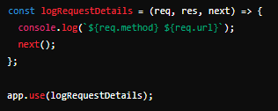
Creating Custom Middleware
Steps
Define a function with req, res, and next as parameters
Perform operations on req or res
Call next() to pass control to the next middleware
Example Code

Slide 8
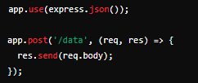
Using Built-in Middleware
Example
Use express.json() to parse JSON bodies
Example Code

Slide 9
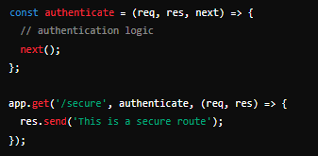
Applying Middleware to Specific Routes
Route-Specific Middleware
Middleware can be applied to specific routes by passing it as a parameter
Example Code

Slide 10

What is middleware in Express?
Functions that have access to the request object (req), the response object (res), and the next middleware function
How do you apply middleware globally in an Express application?
Using the app.use() method
Provide an example of built-in middleware in Express
app.use(express.json());
How do you pass control to the next middleware function in the stack?
By calling the next() function within a middleware function.
Can you apply middleware to specific routes? Provide an example.
The res.render() method

Slide 11

Task
Create a middleware function that logs request details and apply it to an Express application.

